Slide 1

course: AWS devops Trainer: Mr.Madhukar
ASSIGNMENT – 5
Name : saritha
Email id : dosalasaritha123@gmail.com

Slide 2
1.Create two branches and merge them,create a directory and push in the repository ,commit the changes to the file and use cheery pick to commit changes between branches
Open the git bash and create directory in desktop
We use command : mkdir <name>
Intialize the created directory command is “git init”
Default branch is “ master”

Slide 3
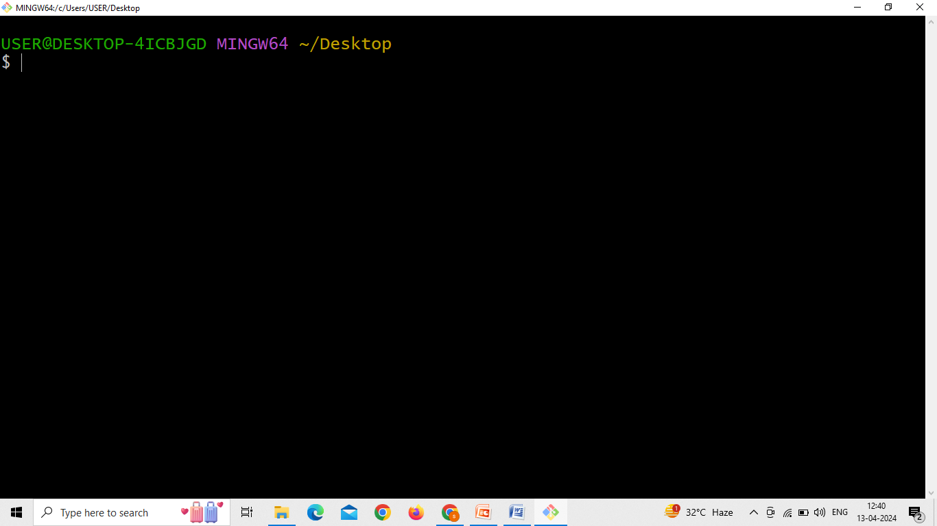
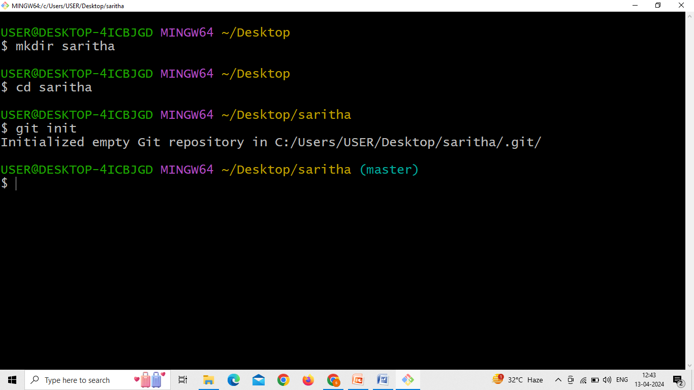

Slide 4
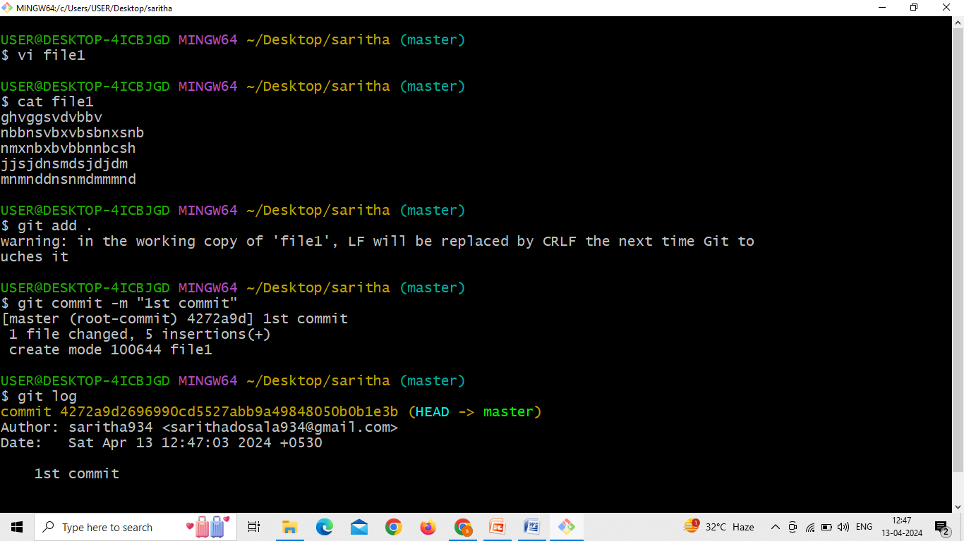
Now create a file in master branch

Slide 5
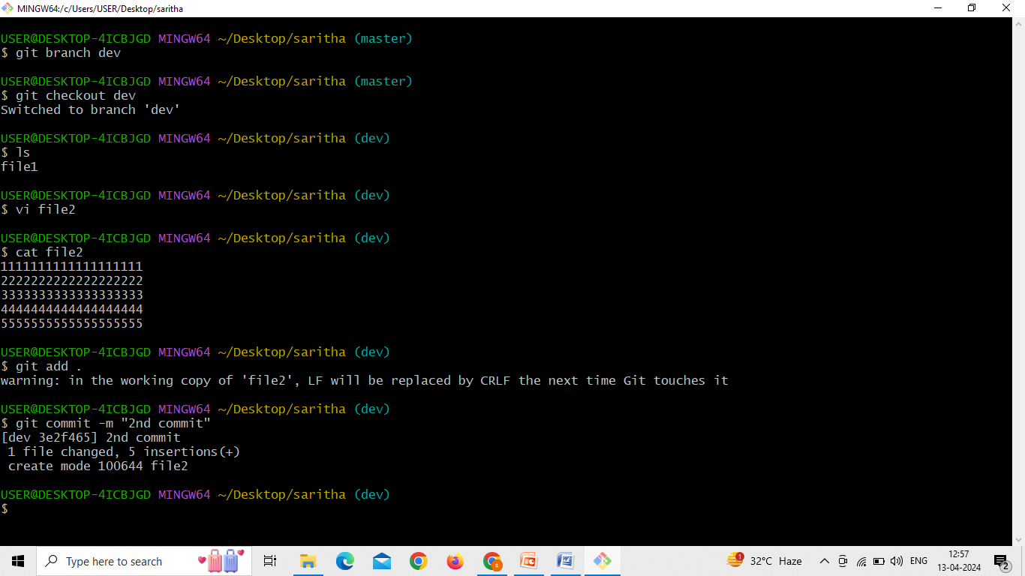
Now create branch and create files in new branch
Brach create & switch commands are
git branch <branch name>
git checkout <branch name>

Slide 6
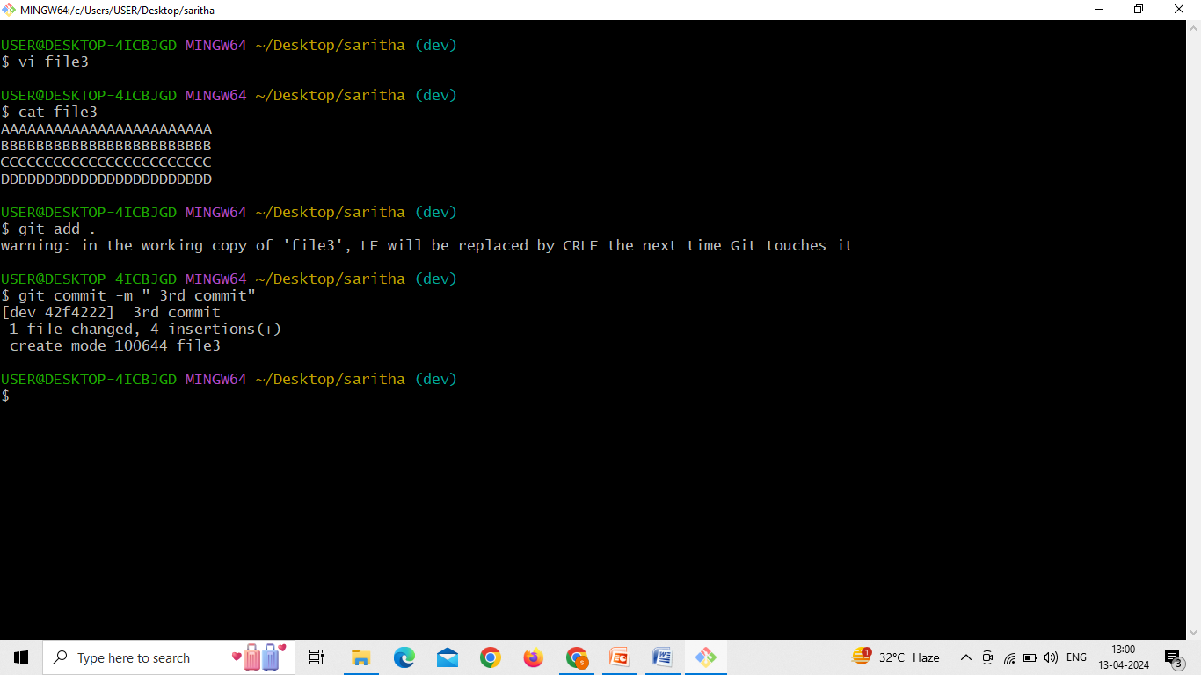
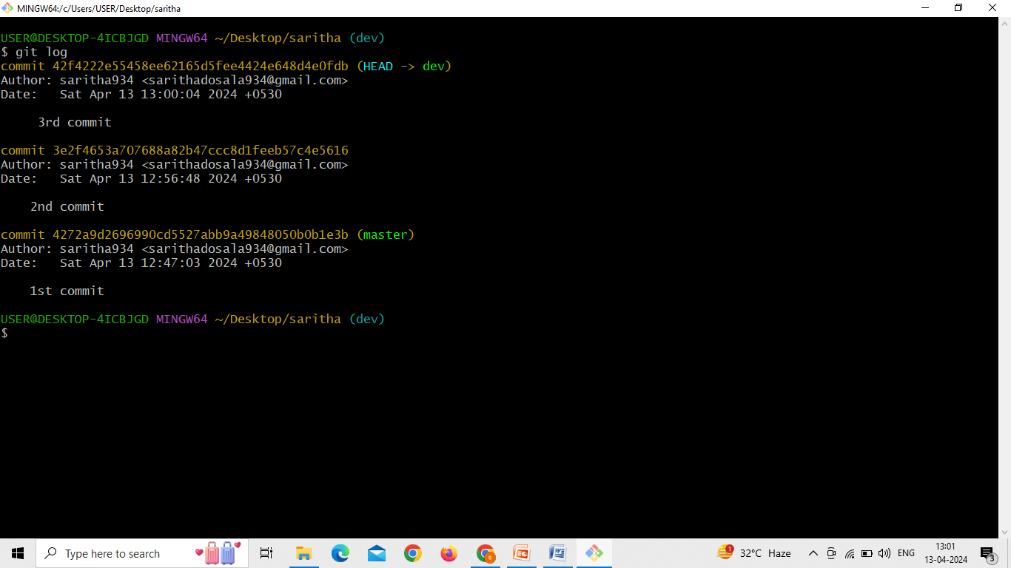

Slide 7
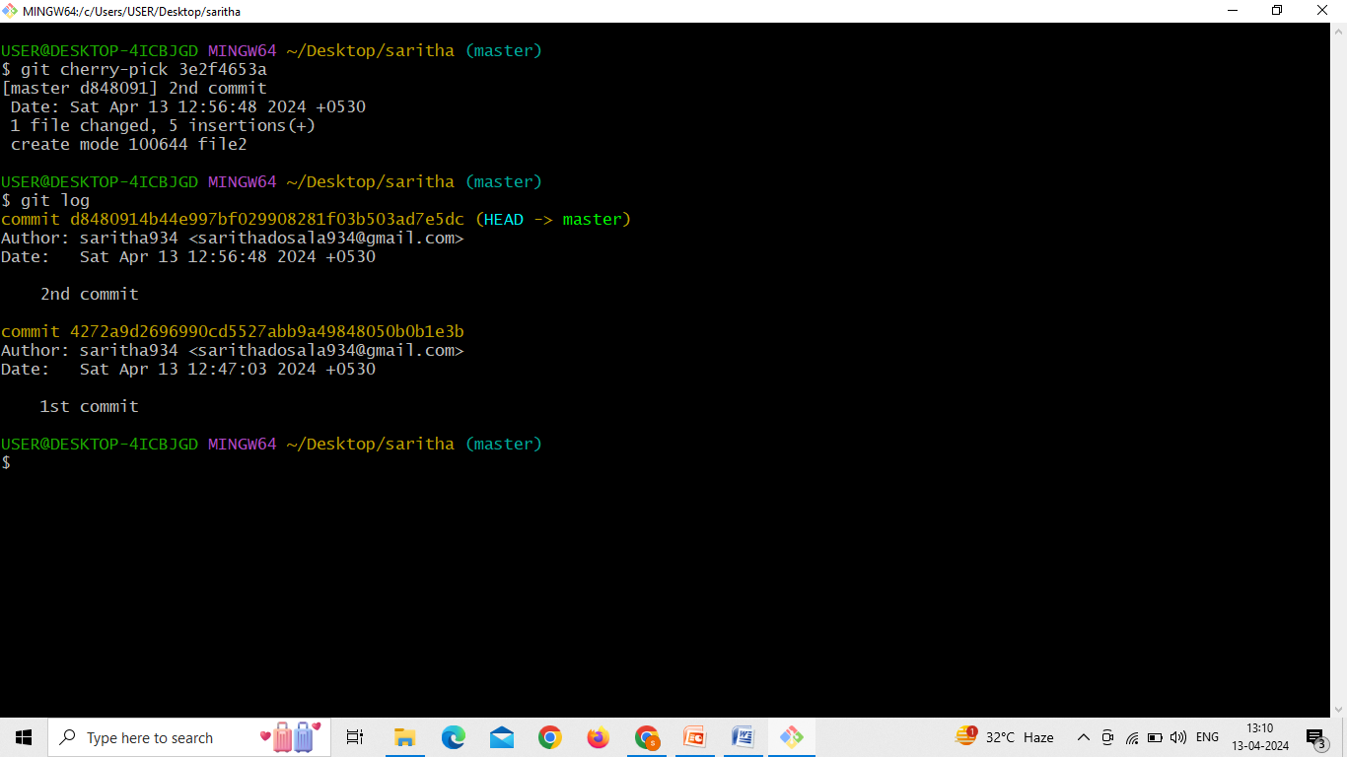
Now using cherry-pick command we require file to be copied into one branch to another branch
git cherry-pick < paste the commit id first letters what u want>

Slide 8
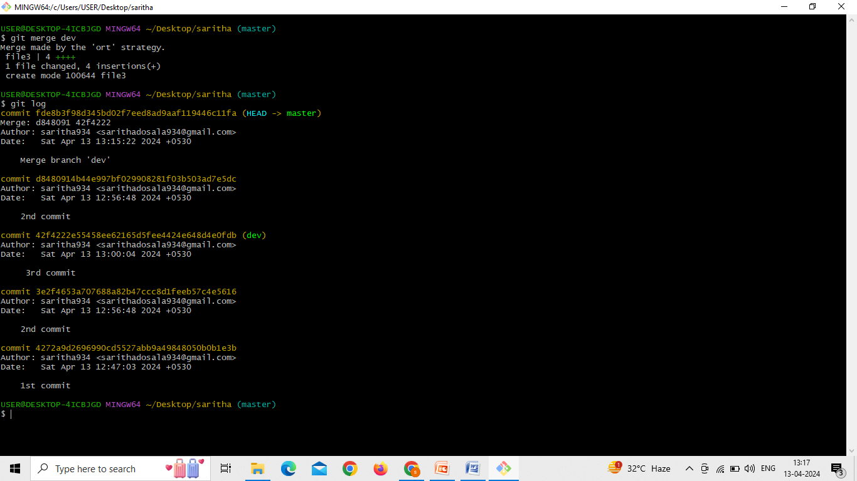
Now to branches merge and push into the repository
git merge < branch name>

Slide 9
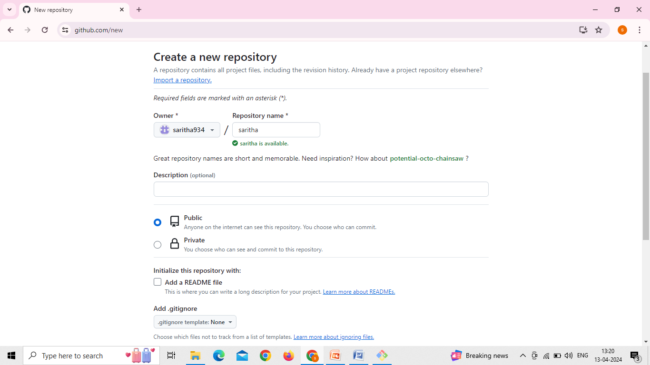
Now go to github account and create a new repository

Slide 10
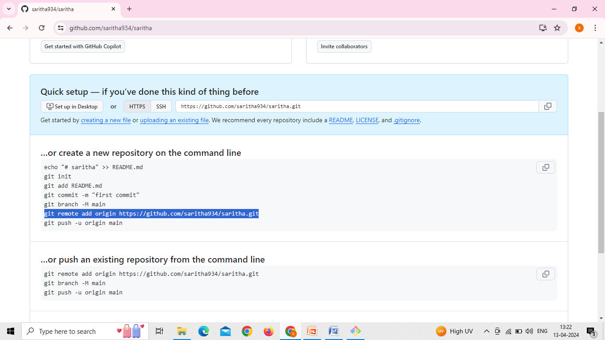
Copy the remote add origin and URL paste on the git bash

Slide 11
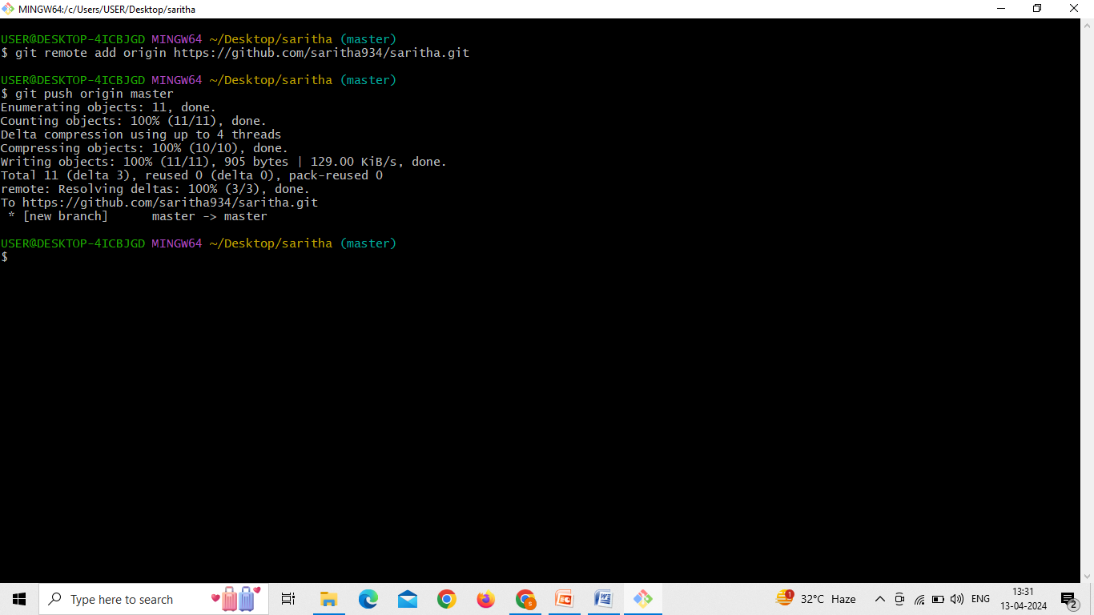
“git push origin master” using this command to upolad files in the repository
Now we can see the files in git repository

Slide 12
